Slide 1



Creating Graphical User Interface
(GUI & Swing, Part 5)
Book: Chapter 12: Layout Managers

Slide 2
Contents
Layout Manager Theory
Some Pre-defined Layout in Java API
A demonstration
Other layout options

Slide 3
Layout Manager Theory
  Layout manager: an object that implements the java.awt.LayoutManager interface and determines the size and position of the components within a container.
Although components can provide size and alignment hints, a container's layout manager has the final say on the size and position of the components within the container
Every container has a default layout manager: Frame (BorderLayout), Panel (FlowLayout).

Slide 4
Layout Manager Theory
  The AWT Toolkit ( java.awt package) includes 5 main layout manager classes:
    Flow Layout
    Grid Layout
    Border Layout
    Card Layout
    Gridbag Layout

Slide 5
The FlowLayout Class
Arranges components in horizontal rows (left to right in the order they were added to their container), starting new rows if necessary
Fits as many components as possible into the top row and spills the remainder into a second row
Leaves a gap of five pixels between components in both horizontal and vertical direction by default
To change the default gap, the constructor should be called
Is the default layout manager for any JPanel

Slide 6
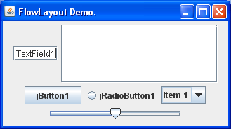
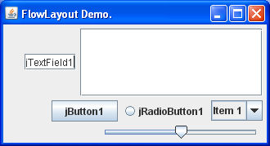
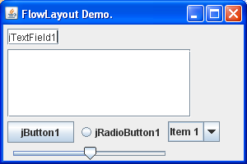
The FlowLayout Class
Constructors
FlowLayout() // align= center, vgap=hgap=5 units.
FlowLayout(int align) // vgap=hgap=5 units
FlowLayout(int align, int hgap, int vgap)
Constants for alignment:
LEFT CENTER RIGHT LEADING TRAILING
Instructor guide student exploring this layout
(Use step-by-step manner)

Slide 7
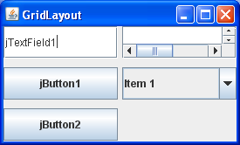
The GridLayout Class
Subdivides its territory into a matrix of rows and columns.
  The number of rows and number of columns are specified as parameters to the manager’s constructor.
  When it performs a layout in a given space, it ignores a component’s preferred size
  Number of rows can not be changed but the number of columns is automatically updated (Java 1.6).

Slide 8
The GridLayout Class
Constructor
GridLayout() // 1x1
GridLayout(int rows, int cols)
GridLayout(int rows, int cols,int hgap,int vgap)
Instructor guide student exploring this layout
(Use step-by-step manner)

Slide 9
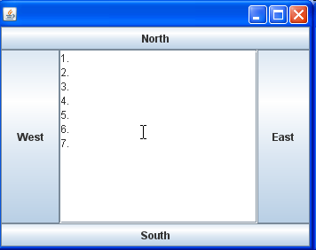
The BorderLayout Class
Default layout of a frame.
Divides its territory into five regions:
  North (useful for toolbar)
  South (useful for status bar)
  East, West, Center
Each region may be empty or may contain one component.

Slide 10
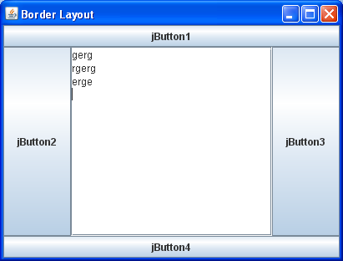
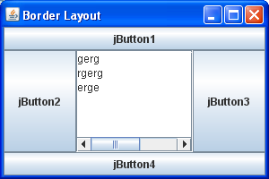
The BorderLayout Class
After a component is added to the North and South regions, The height which the component occupied, can not be vertically resized.
Similarly for the East and West regions.
Instructor guide student exploring this layout
(Use step-by-step manner)

Slide 11
The BorderLayout Class
EAST
LINE_END
WEST
LINE_START
SOUTH
PAGE_END
NORTH
PAGE_START
CENTER
The default region is CENTER region.
If there is only one component at the center, this component will cover all the container.
Constructors:
  BorderLayout()
  BorderLayout (int hgap, int vgap)
Add a component to the container:
Container.add("East", componentName); // or
Container.add(componentName ,"East"); // or
Container.add(BorderLayout.EAST, componentName); // or
Container.add(componentName , BorderLayout.EAST);
Container.add(componentName); // add to center

Slide 12
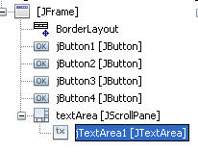
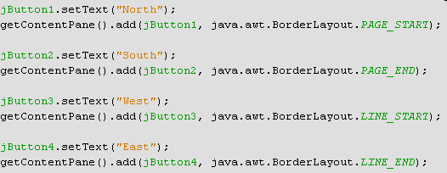
BorderLayout…

Slide 13
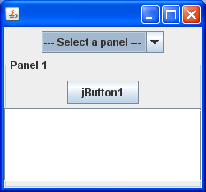
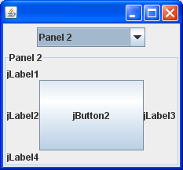
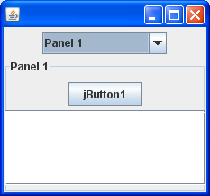

The CardLayout Class
The CardLayout class helps you manage two or more components (usually JPanel instances) that share the same display space.
When using CardLayout, you need to provide a way to let the user choose between the components. The above demonstration uses a combo box for this purpose.
An easier but less flexible way to accomplish the same task is to use a tabbed pane.

Slide 14
CardLayout…
Main panel contains a card layout.
Each sub-panel has a name that is identified by the card layout.
At a time, only one sub-panel is seen by user (current panel).
Show a sub-panel:
  Card.first(mainPanel);
  Card.next(mainPanel);
  Card.previous(mainPanel);
  Card.last(mainPanel);
  Card.show(mainPanel, subPanelName);

Slide 15
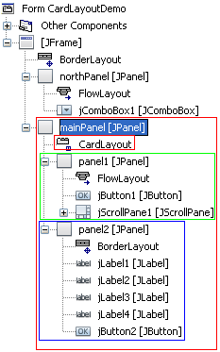

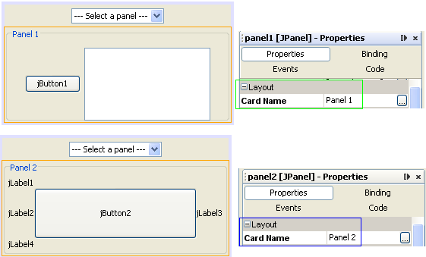
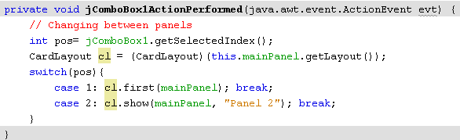
Demo 10: CardLayout

Slide 16
The GridBagLayout Class
Is the most powerful layout manager.
It can perform the work of the Flow, Grid, and Border layout managers if appropriately programmed and is capable of much more, often without the need for nesting multiple panels as is so often required with the other layout managers
Divides its container into an array of cells:
  Different cell rows can have different heights,
  And different cell columns can have different widths.
Requires a lot of information to know where to put a component. A helper class called GridBagConstraints is used to hold all the layout position information.
To add the component, the add(Component, Object) is used

Slide 17
GridBagLayout …
Designing a Layout with GridBag
  Three levels of control are applied to a GridBag layout to make up the final layout in the container.
    The sizes of the various rows and columns, along with the way they stretch when the container is resized.
    The cell (or cells) that provides the target space for each component is determined.
    The final control determines how each component is stretched to fit or, if it isn’t, how the component is positioned within the target space.

Slide 18
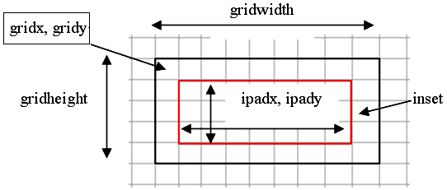
GridBagLayout …
Parameters are used to draw a component in a GridBag Layout:

Slide 19
GridBagLayout …
Controlling the Rows and Columns
  gridx, gridy: Specify the row and column at the upper left of the component .
  gridwidth, gridheight : Specify the number of columns (for gridwidth) or rows (for gridheight) in the component's display area.
  Fill :Used when the component's display area is larger than the component's requested size to determine whether and how to resize the component.
  ipadx, ipady: How much to add to the minimum size of the component. The default value is zero. The width of the component will be at least its minimum width plus ipadx*2 pixels.
  insets :The minimum amount of space between the component & the edges of its display area.
  Anchor:Used when the component is smaller than its display area to determine where (within the area) to place the component.
  weightx, weighty : Weights are used to determine how to distribute space among columns (weightx) and among rows (weighty); this is important for specifying resizing behavior

Slide 20
Other Layout Options
If you are in a situation where Flow, Grid, Border, Card, and GridBag will not create the layout you need, your choices are:
  To find a layout manager from another source
  To create your own layout manager
  To use no layout manager
    Use setLayout(null) method of the container to set no layout manager.
    No layout honors each component’s x, y, width, and height values. Thus, you can call setBounds() on a component, add() it to a container that has no layout manager, and have the component end up where you expect it to be.
    Disadvantages: Have to write code to detect when the container resizes, and more code to do the right thing when resizing occurs.

Slide 21
Summary
Layout Manager Theory
Some Pre-defined Layout in Java API
A demonstration
Other layout options

